Slide 1
Software Engineering Project / MAIA Master
Group:
Antoine Merlet, Gülnur Ungan, Mladen Rakic, Marcio Rockenbach
Professors:
Dr. Yohan Fougerolle, Dr. Cansen Jiang, Dr. David Strubel

Slide 2
Table of Contents
Introduction
Choices / Target
Project Management
Results
Future Work
Conclusion
Statistics

Slide 3
Introduction
Context
Current state

Slide 4
Choices / Target
Organization of the code
Interfacing
Documentation
Variety of choices
GUI

Slide 5
GUI
Simplicity
Power
Diversity
Organization
Main window
Scan window
Filter window
Register window

Slide 6
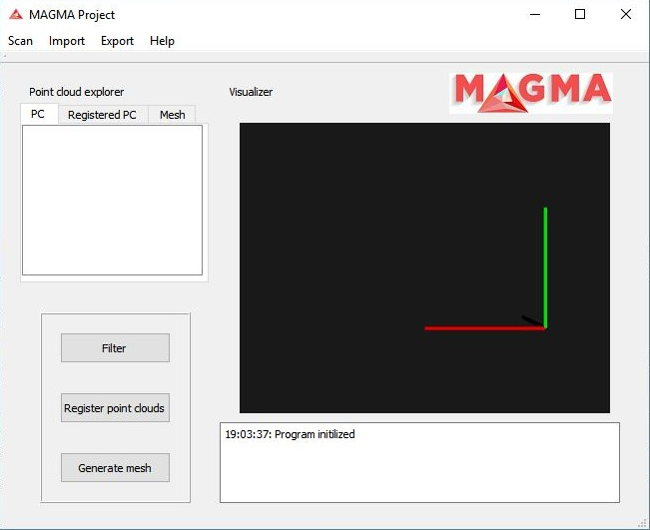
GUI – Main window

Slide 7
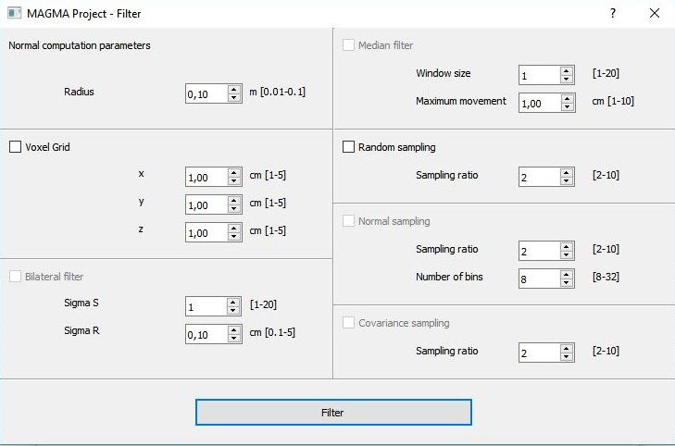
GUI – Filtering window

Slide 8
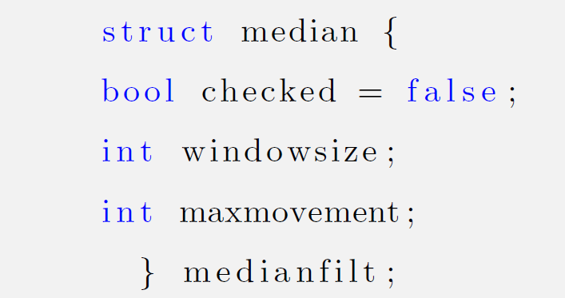
GUI - example

Slide 9
Future Work

Slide 10
Conclusion

